Slide 1
Adversarial Examples
Handcrafted inputs, that cause a neural network to predict a wrong class with high confidence

Slide 2
What is an Adversarial Example
Adversarial examples are inputs to machine learning models that an attacker has intentionally designed to cause the model to make a mistake; they’re like optical illusions for machines
CNN’s, can be fooled by making “Perturbations” - small changes in the pixel values of an input image and the classifier will predict it to be another class.

Slide 3
A good Adversarial Example, is indistinguishable to the human eye.
Adversarial Examples, generalize well across different models.
Can be produced for any target label.
Printing adversarial images then photographing them can retain their adversarial property.

Slide 4
What are their implications?
Stealing the identity of someone by wearing special glasses. Misleading a self-driving car by altering traffic signs. Disguise a weapon to avoid video detection. Bypass audio or fingerprint identification.

Slide 5
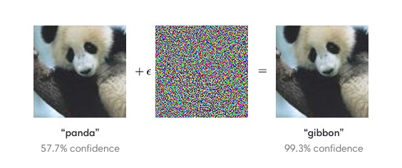
Adversarial Examples
An adversarial input, overlaid on a typical image,
can cause a classifier to wrongly label a panda as a gibbon.

Slide 6
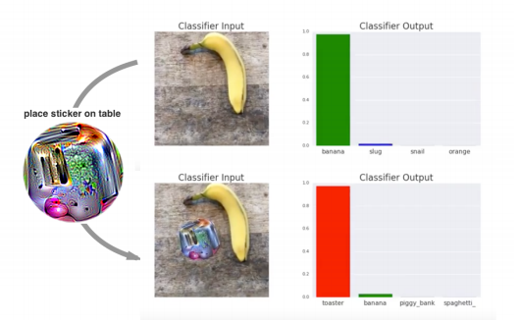
Placing a sticker next to an object
Most of the classifiers can be fooled by making small changes in the pixel values of an input image and the classifier will predict it to be any class your choice.

Slide 7
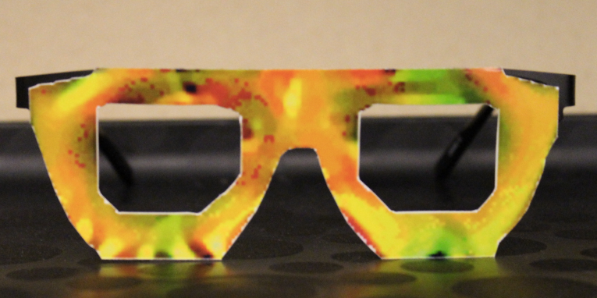
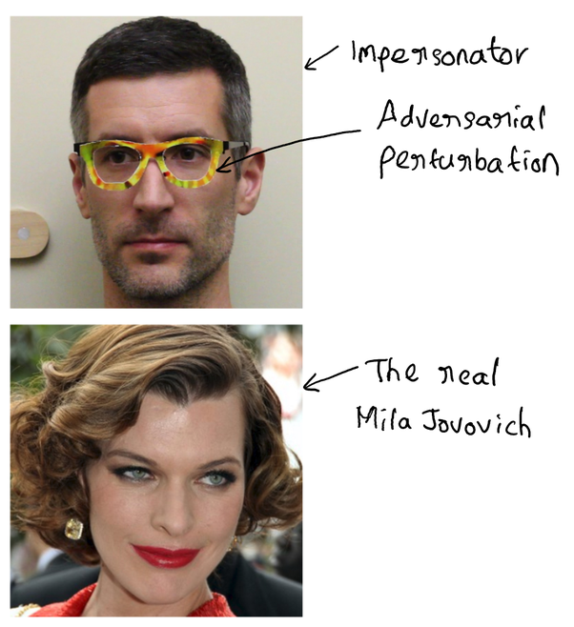
Adversarial Examples
Above Glasses, can fool commercial-grade facial recognition software into identifying the wrong person with up to 100% success rates. Researchers had the same success tricking software touted by Chinese e-commerce giant Alibaba for use in their “smile-to-pay” feature.

Slide 8
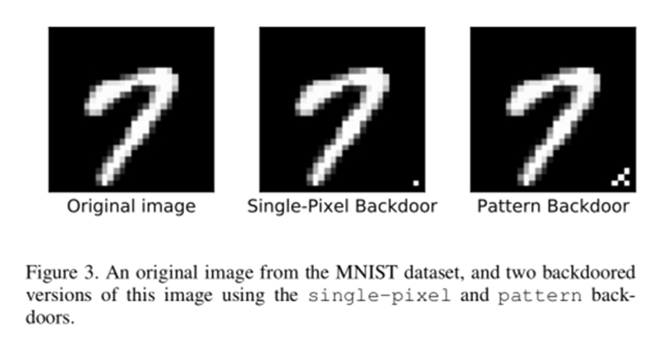
Poisoning the Training Set

Slide 9
Poisoning Attacks on Neural Nets
The existence of adversarial examples in deep neural networks (DNNs) has triggered debates on how secure these classifiers are.
Adversarial examples fall within a category of attacks called evasion attacks.
Evasion attacks happen at test time – a clean target instance is modified to avoid detection by a classifier, or spur misclassification.
Poison attacks work in cases where adversarial perturbations don’t.
Data poisoning attacks, happen at training time; they aim to manipulate the performance of a system by inserting carefully constructed poison instances into the training data. Sometimes, a system can be poisoned with just one single poison image, and this image won’t look suspicious, even to a trained observer.

Slide 10
In “clean label” attacks, the poison image looks totally innocuous, and is labelled properly according to a human observer.
This makes it possible to poison a machine learning dataset without having any inside access to the dataset creating process.
Clean label attacks are a threat when…
An attacker leaves an image on the web, and waits for it to be picked up by a bot that scrapes data. The image is then labelled by an expert, and placed into the dataset.
A malicious insider wants to execute an attack that will not be detected by an auditor or supervisor.
Unverified users can submit training data: this is the case for numerous malware databases, spam filters, smart cameras, etc.
eg, suppose a company asks employees to submit a photo ID for its facial recognition control system; an employee provides a poisoned photo, and this gives the employee back-door control of the face recognition system.

Slide 11
DARTS Deceiving Autonomous caRs with Toxic Signs
Sign recognition is an integral part of autonomous cars.
Misclassification of traffic signs can lead to a multitude of disastrous consequences, ranging from a life-threatening accident to even a large-scale interruption of transportation services relying on autonomous cars.

Slide 12
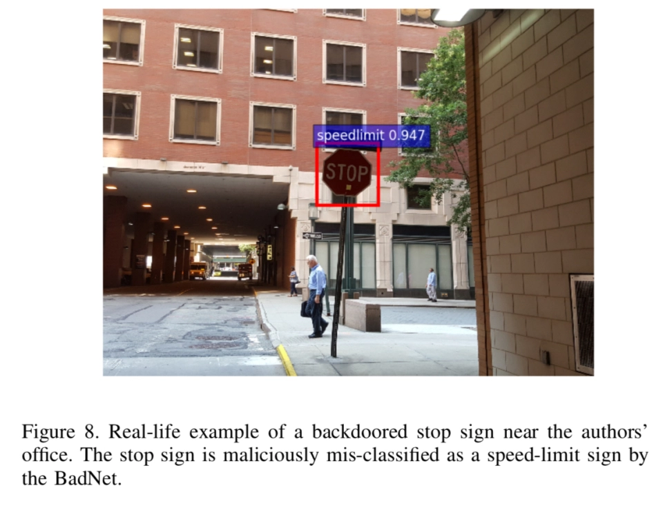
https://www.youtube.com/watch?v=hU7yHQkg-7U
Road Traffic Detection ( one of the eg’s)

Slide 13
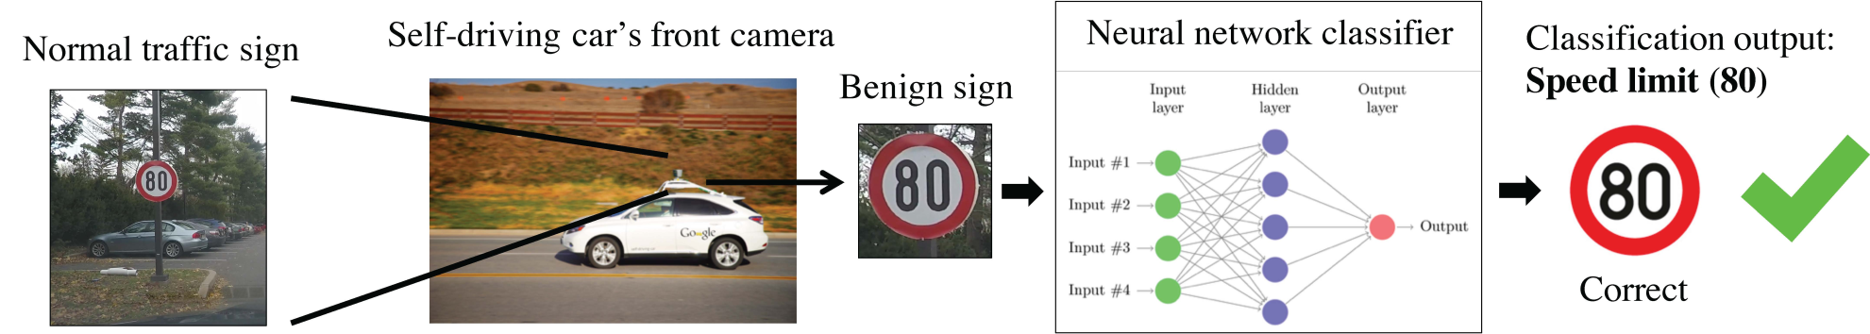
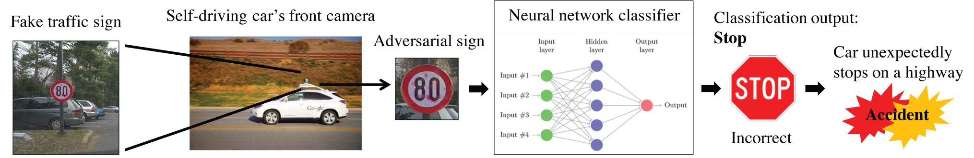
Adversarial Traffic Signs

Slide 14
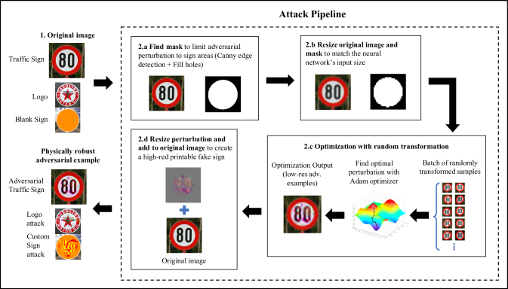

Slide 15
Some Attack Types
Sign Embedding attack, where the adversary is free to disguise adversarial examples as advertisement signs, drawings, graffiti, etc.
Adversarial Traffic Sign attack, where the adversary modifies existing traffic signs to make them adversarial.
From a practical standpoint, installing a modified traffic sign is likely to be draw more attention than an innocuous logo, which leads us to believe that the Sign Embedding attack is more practical.

Slide 16
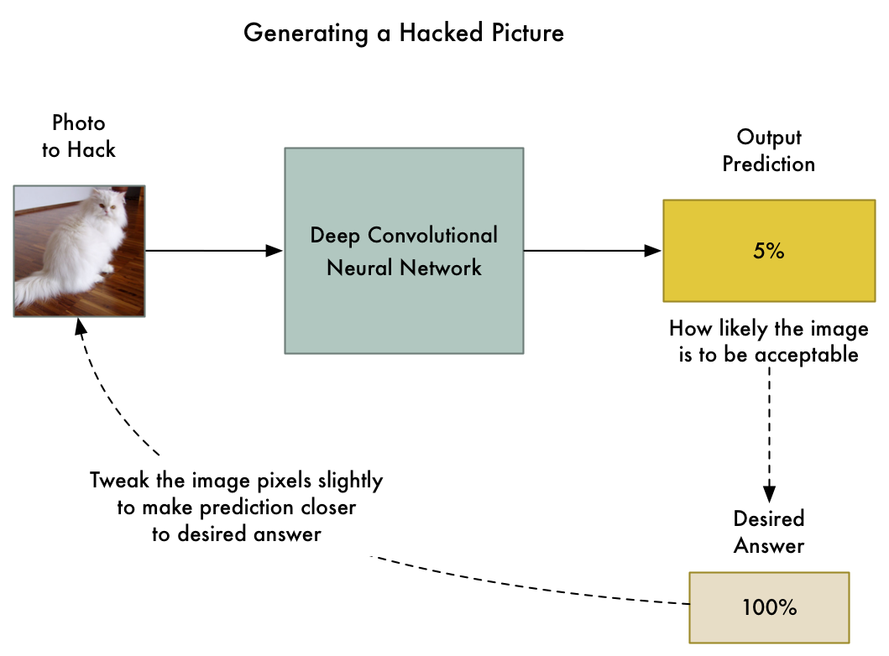
Simple way to create an Adversarial Example

Slide 17
Demos

Slide 18
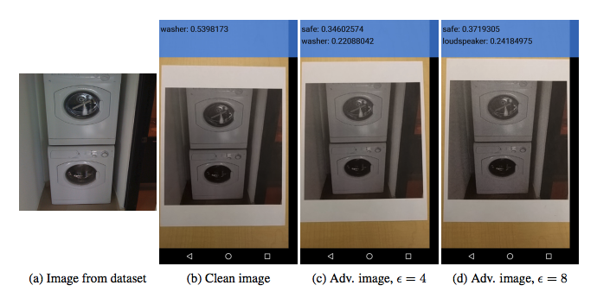
Adversarial example
Adversarial examples can be printed and photographed with a standard resolution smartphone and still cause a classifier to, in this case, label a “washer” as a “safe”.
DEMO
Inception Image Predictor
A1.png, A2.png,A3.png,A4.png

Slide 19
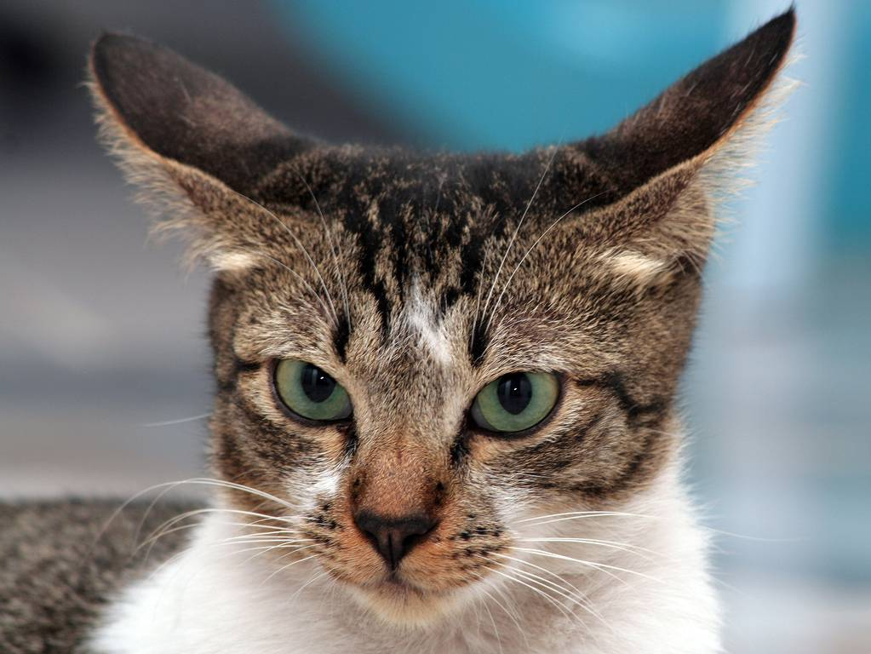

Identify the Hacked Image
CAT1.png
CAT2.png
One of them is classified as an Indian Elephant

Slide 20
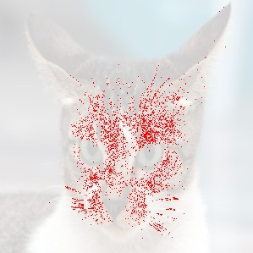
Pixel differences between the images
https://online-image-comparison.com/

Slide 21
Demo
Create an Adversarial Example of a given Sample Image.
We are going to perturb it, so that the Classifier recognizes it as an Indian Elephant, with High Confidence.
Jupyter CodeBooks
Creating an Adversarial.ipynb
Inception Image Predictor.ipynb

Slide 22
GANS Generative Adversarial Network
Neural networks that learn to create synthetic data similar to some known input data.
We have two neural networks
Generator
Discriminator
They compete against each other to succeed in a game.
The object of the game is for the generator to fool the discriminator with examples that look similar to the training set.
GANs’ potential is huge, because they can learn to mimic any distribution of data.
GANs can be taught to create worlds very similar to our own in any domain: images, music, speech, prose.
This idea was first proposed in a research paper, “Generative Adversarial Nets,” by Ian J. Goodfellow, Jean Pouget-Abadie, Mehdi Mirza, Bing Xu, David Warde-Farley, Sherjil Ozair, Aaron Courville and Yoshua Bengio .

Slide 23
HOW Does a GAN Work
The Generator , starts with some NOISE, which is some probability distribution.
Using this NOISE, it creates a FAKE IMAGE
STEP 0:
This FAKE IMAGE is passed to the Discriminator. .
The discriminator takes in both real and fake images and returns probabilities,
a number between 0(fake) and 1( real).
If it says NO, the Discriminator sends a signal to the Generator saying how close it is to
An actual example, and how it should proceed.
Using this information, the Generator creates a new FAKE IMAGE
Goes back to STEP0

Slide 24
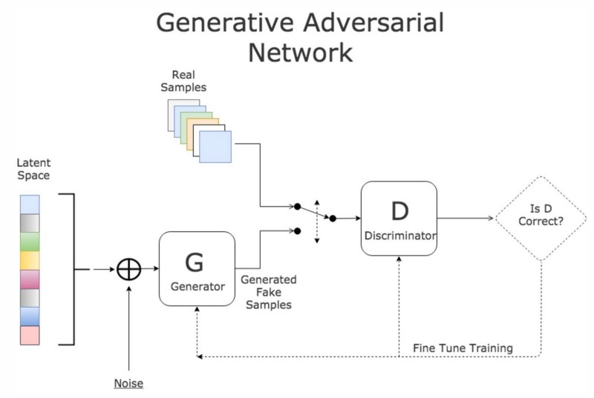

Slide 25
Next Meeting Agenda
Transfer Learning
Adversarial Examples
GANS - Generative Adversarial Networks

Slide 26
QUESTIONS

Slide 27
Contact Details
Email: aliasgertalib@gmail.com
Linkedin: https://www.linkedin.com/in/aliasgertalib

